Slide 1
Combinational Digital Circuit

Slide 2
Lecture 33 Encoders and Decoders
Lecture delivered by:
Deepak V.

Slide 3
Objectives
At the end of this lecture, student will be able to:
Acquire the knowledge of Encoders
Describe Decoders

Slide 4
Topics
Encoders
Decoders

Slide 5
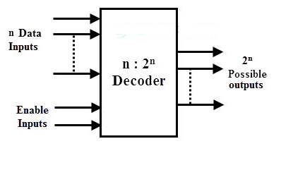
Decoders
A decoder is a combinational circuit that converts binary information from n input lines to a maximum of 2^{n} unique output lines
Decoder Block diagram

Slide 6
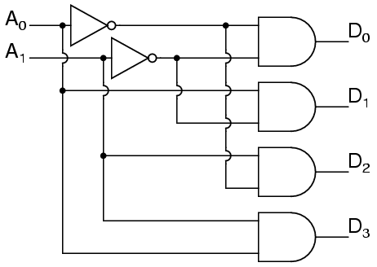
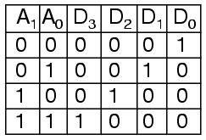
Decoders
A 2:4 decoder is shown below along with its truth table
2:4 Decoder truth table
2:4 Decoder

Slide 7
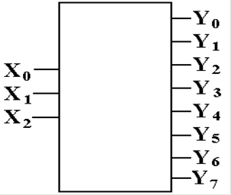
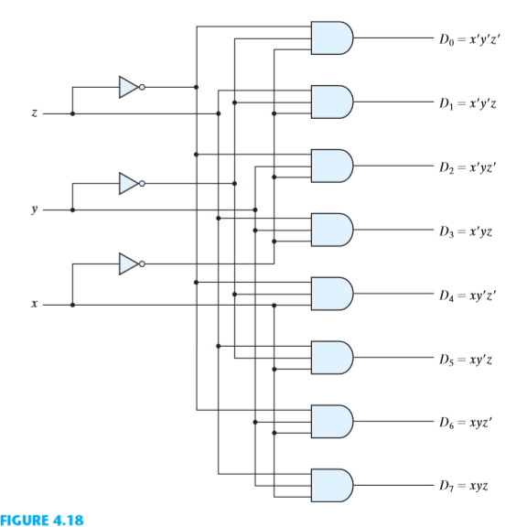
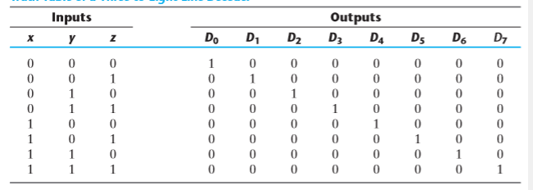
Decoders
A 3:8 line decoder is shown below along with its truth table
3:8 line decoder
Block diagram
3:8 line decoder
3:8 line decoder truth table

Slide 8
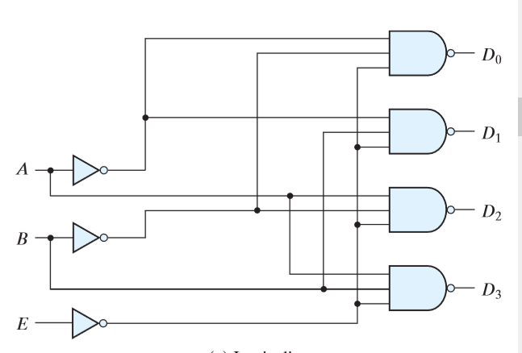
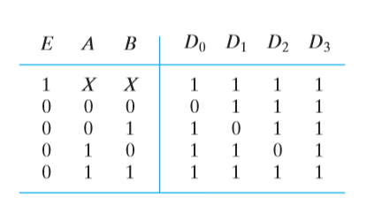
Decoders
A 2:4 Decoder using NAND gate is shown below
Also observe the function of enable pin
2:4 Decoder using NAND gate
2:4 Decoder Truth table

Slide 9
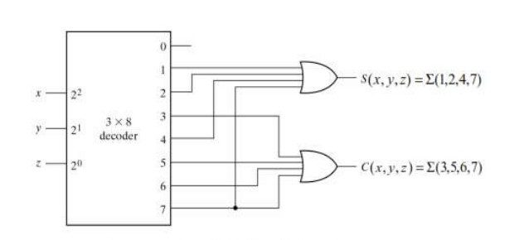
Decoders
Implementation of full adder using a decoder
Half adder using 3:8 Decoder
Truth table for 3:8 Decoder

Slide 10
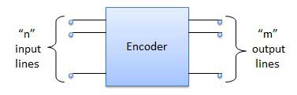
Encoders
An encoder is a digital circuit that performs the inverse operation of a decoder
An encoder has 2^{n} (or fewer) input lines and n output lines
The output lines generate the binary code corresponding to the input value
Encoder Block Diagram

Slide 11
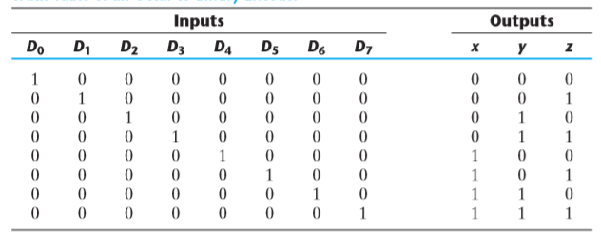
Encoders
An example of an encoder is the octal-to-binary encoder whose truth table is given in table below
octal-to-binary encoder truth table
z = D1 + D3 + D5 + D7
y = D2 + D3 + D6 + D7
x = D4 + D5 + D6 + D7

Slide 12
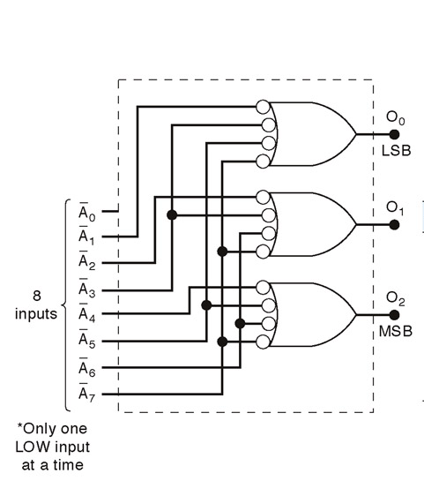
Encoders
Logic circuit for octal-to binary encoder [8-line- 3-line ]
Logic circuit for a 8-3 line octal to binary encoder

Slide 13
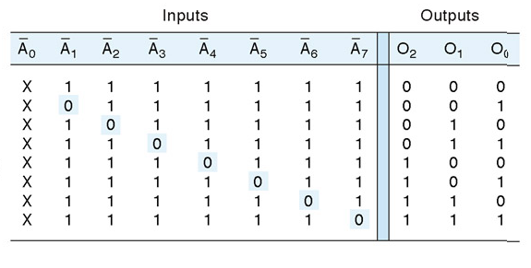
Encoders
Truth table for octal-to binary encoder [8-line- 3-line ]

Slide 14
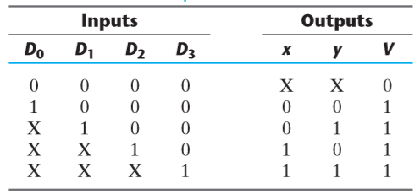
Priority Encoders
A priority encoder is an encoder circuit that includes the priority function
The operation of the priority encoder is such that if two or more inputs are equal to 1 at the same time, the input having the highest priority will take precedence
The truth table of a four-input priority encoder is given below:
Truth table for priority encoder

Slide 15
Priority Encoders
In addition to the two outputs x and y , the circuit has a third output designated by V
This is a valid bit indicator that is set to 1 when one or more inputs are equal to 1
Note that whereas X ’ s in output columns represent don’t-care conditions, the X ’ s in the input columns are useful for representing a truth table in condensed form
According to Table, the higher the subscript number, the higher the priority of the input
Input D3 has the highest priority, so, regardless of the values of the other inputs, when this input is 1, the output for xy is 11

Slide 16
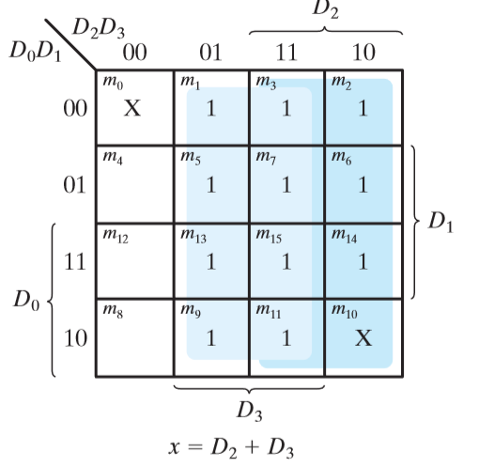
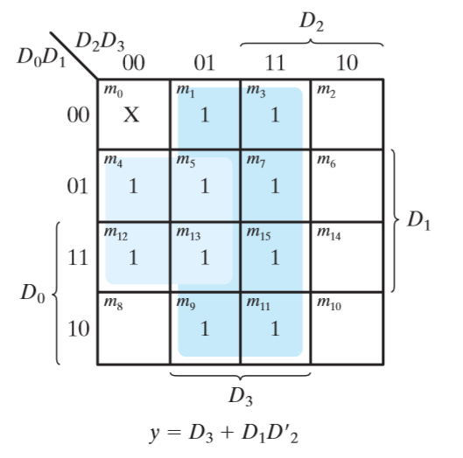
Priority Encoders
The maps for simplifying outputs x and y are shown in figure below
K-Map for deriving the Boolean function

Slide 17
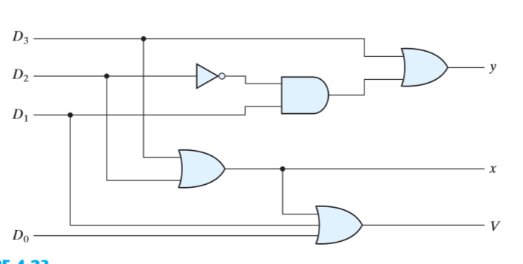
Priority Encoders
The Boolean functions thus obtained is :
x = D2 + D3
y = D3 + D1 D2’
V = D0 + D1 + D2 + D3
Logic diagram for 4 input priority encoder

Slide 18
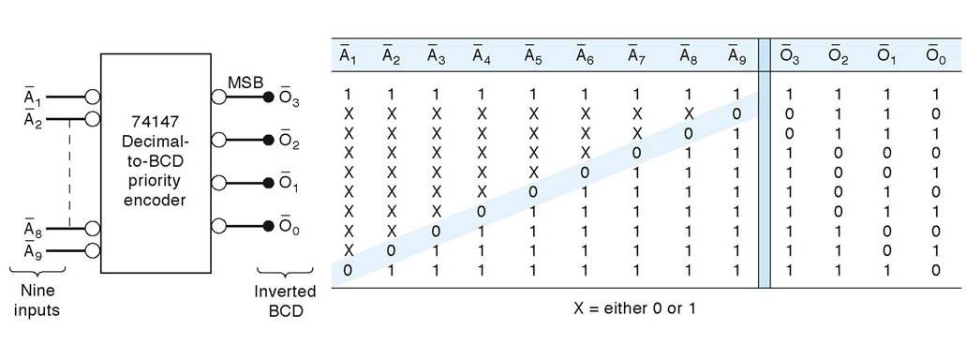
Decimal to BCD Priority Encoders

Slide 19
Summary
A decoder is a combinational circuit that converts binary information from n input lines to a maximum of 2^{n} unique output lines
An encoder is a digital circuit that performs the inverse operation of a decoder
An encoder has 2^{n} (or fewer) input lines and n output lines
The operation of the priority encoder is such that if two or more inputs are equal to 1 at the same time, the input having the highest priority will take precedence

